Slide 1
Transmission Impairments

Slide 2
Transmission Impairments
› Signal received may be different from signal transmitted causing:
⁾ Analog: degradation of signal quality
⁾ Digital: bit errors
› Most significant impairments:
1.Attenuation and attenuation distortion
2.Delay distortion
3.Noise

Slide 3
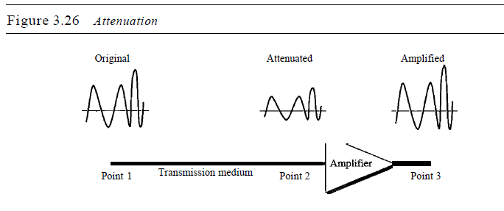
Attenuation
Signal strength reduces as a function of distance
Some of the electrical energy in the signal is converted to heat.
To compensate for this loss, amplifiers are used
Guided media ➔ exponential
Unguided media, ➔ a more complex function of distance and the
makeup of the atmosphere

Slide 4
Designing a transmission system:
Received signal must have sufficient strength so that the electronic circuitry in the receiver can detect the signal
The signal must maintain a level sufficiently higher than noise to be received without error
Attenuation varies with frequency

Slide 5
The first and second problems are dealt with by attention to signal strength and the use of amplifiers or repeaters.
The third problem is dealt with equalizing attenuation across a band of frequencies.
Another approach is to use amplifiers that amplify high frequencies more than lower frequencies.

Slide 6

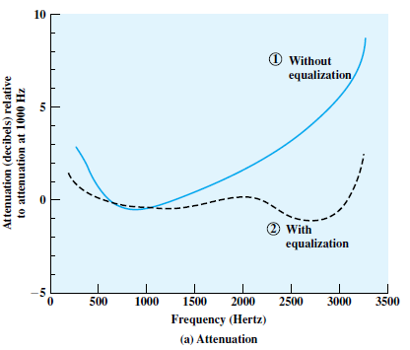

Slide 7
Delay Distortion
Delay distortion occurs because the velocity of propagation of a signal through a guided medium varies with frequency.
For a bandlimited signal, the velocity tends to be highest near the center frequency and fall off toward the two edges of the band.
Thus various frequency components of a signal will arrive at the receiver at different times, resulting in phase shifts between the different frequencies.
Received signal is distorted due to varying delays experienced at its constituent frequencies.

Slide 8
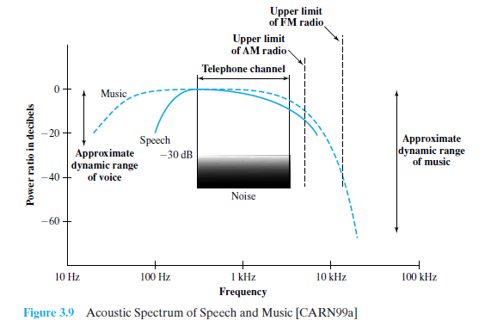

Slide 9
Because of delay distortion, some of the signal components of one bit position will spill over into other bit positions, causing intersymbol interference
10001010➔10001001
Equalizing techniques(Delay Equalizer) can also be used for delay distortion.

Slide 10
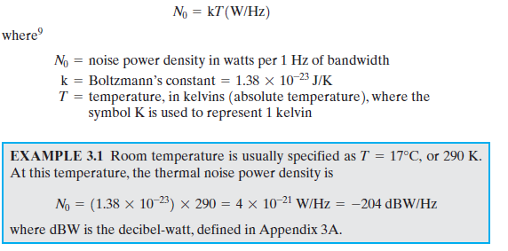
Noise
Additional unwanted signals that are inserted somewhere between transmission and reception
Thermal Noise(white noise)
› Due to thermal agitation of electrons
› Present in all transmission devices and media
The amount of thermal noise to be found in a bandwidth of 1 Hz in any device
or conductor is

Slide 11
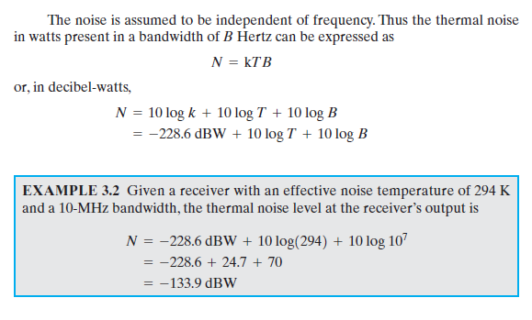

Slide 12
Noise
Intermodulation noise.
When signals at different frequencies share the same transmission medium, the result may be intermodulation noise.
2f, 5f, 7f ➔7f,7f
Crosstalk
› Unwanted coupling of different signals
Impulse Noise
› Short peak of noise, e.g. lightning, electrical disturbances, flaws in communications system

Slide 13
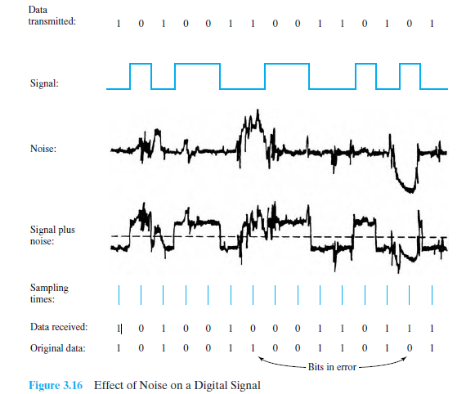
Effect of Noise on a Digital Signal

Slide 14
Channel Capacity
› Channel capacity: maximum data rate at which data can be transmitted over a given communication channel
› Relate:
⁾ Data rate, C [bits per second]
⁾ Bandwidth, B [Hertz]
⁾ Noise
⁾ Error rate
› Two theoretical models:
Nyquist Capacity:assumes noise-free environment
Shannon Capacity:considers noise

Slide 15
Nyquist Capacity
› Assumes channel that is noise free
› Given a bandwidth of B, the highest signal rate is 2B
› Single signal element may carry more than 1 bit; signal with M levels may carry log₂ M bits
C = 2B log₂ M
› Tradeoffs:
⁾ Increase the bandwidth, increases the data rate
⁾ Increase the signal levels, increases the data rate
⁾ Increase the signal levels, harder for receiver to interpret the bits (practical limit to M)

Slide 16
Example of Nyquist Capacity
A telephone system with modem allows bandwidth of 3100 Hz. What is the maximum data rate? M=2

